Slide 1
Microprocessor BSc CSIT II SEM
Introduction
Chapter One
Bijay Babu Regmi
bijay.regmi@deerwalk.edu.np

Slide 2
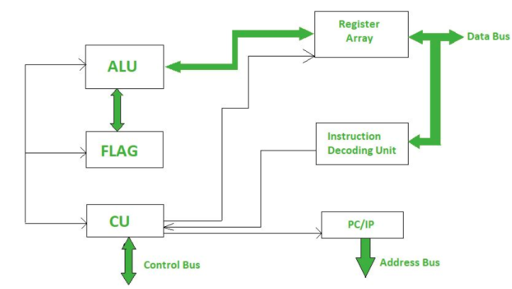
Introduction to Microprocessor
The microprocessor is a multipurpose, clock driven, register based, digital integrated circuit which accepts binary data as input, processes it according to instructions stored in its memory and provides result as output.
Microprocessor is a computer Central Processing Input (CPU) on a single chip that contains millions of transistors connected by wires.
It is designed to perform arithmetic and logic operations that make use of small number holding area called registers.
The data in Microprocessor can move from one location to another.
It has a Program Counter (PC) register that stores the address of next instruction based on the value of PC, Microprocessor jumps from one location to another and takes decision.

Slide 3
Evolution of Microprocessor
First Generation (4-bit Microprocessor):
- introduced in the year 1971-1972 by Intel Corporation. It was named Intel 4004 since it was a 4-bit processor.
- It was a processor on a single chip. It could perform simple arithmetic and logical operations such as addition, subtraction, Boolean OR and Boolean AND.
Second Generation (8-bit Microprocessor):
- were introduced in 1973 again by Intel. It was a first 8 - bit microprocessor which could perform arithmetic and logic operations on 8-bit words. It was Intel 8008, and another improved version was Intel 8088.
Third Generation (16-bit Microprocessor):
- The third generation microprocessors, introduced in 1978 were represented by Intel's 8086, Zilog Z800 and 80286, which were 16 - bit processors with a performance like minicomputers.

Slide 4
Continued….
Fourth Generation (32-bit Microprocessor):
- Several different companies introduced the 32-bit microprocessors, but the most popular one is the Intel 80386.
Fifth Generation (64-bit Microprocessor):
- From 1995 to now we are in the fifth generation. After 80856, Intel came out with a new processor namely Pentium processor followed by Pentium Pro CPU, which allows multiple CPUs in a single system to achieve multiprocessing.
- Other improved 64-bit processors are Celeron, Dual, Quad, Octa Core processors.

Slide 5
Features of Microprocessor
Low Cost - Due to integrated circuit technology microprocessors are available at very low cost. It will reduce the cost of a computer system.
High Speed - Due to the technology involved in it, the microprocessor can work at very high speed. It can execute millions of instructions per second.
Small Size - A microprocessor is fabricated in a very less footprint due to very large scale and ultra large scale integration technology. Because of this, the size of the computer system is reduced.
Low Power Consumption - Microprocessors are using metal oxide semiconductor technology, which consumes less power.
Less Heat Generation - Microprocessors uses semiconductor technology which will not emit much heat as compared to vacuum tube devices.

Slide 6
8085 Microprocessor
It is a 40 pin I.C. package fabricated on a single LSI chip.
The Intel 8085 uses a single +5Vd.c. supply for its operation.
Intel 8085’s clock speed is about 3 MHz; the clock cycle is of 320ns.
8-bit data bus
Address bus is of 16-bit, which can address up to 64KB
16-bit stack pointer
16 bit PC (Program Counter)
Six 8-bit registers are arranged in pairs :BC, DE, HL

Slide 7
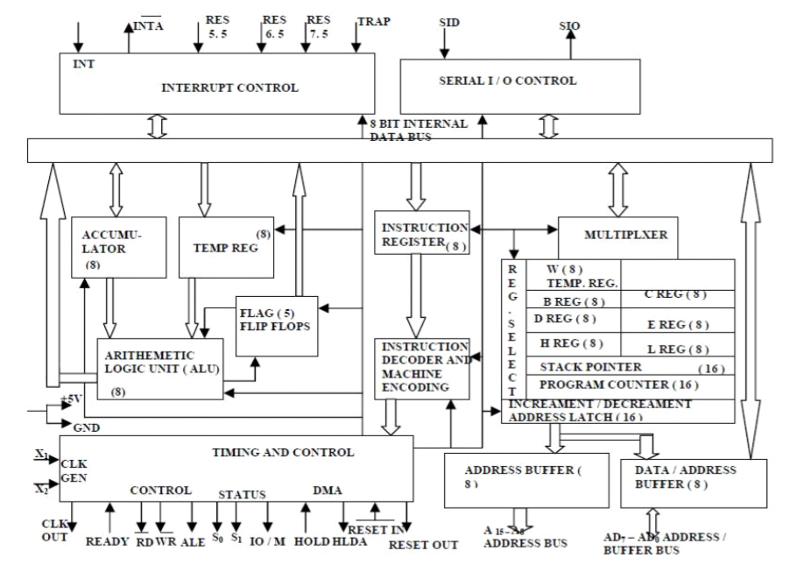
8085 Architecture

Slide 8
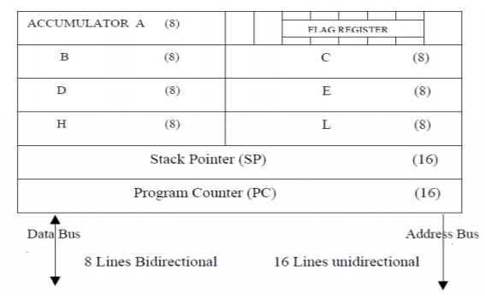
Continued….
Arithmetic and Logic Unit: The ALU performs the arithmetic and logical operations such as Addition (ADD), Subtraction (SUB), AND, OR etc. It uses data from memory and from Accumulator to perform operations. The results of the arithmetic and logical operations are stored in the accumulator.
Registers: The 8085 includes six registers, one accumulator and one flag register. In addition, it has two 16-bit registers: stack pointer and program counter. They are briefly described as follows. The 8085 has six general-purpose registers to store 8-bit data; these are identified as B, C, D, E, H and L. they can be combined as register pairs - BC, DE and HL to perform some 16-bit operations. The programmer can use these registers to store or copy data into the register by using data copy instructions.

Slide 9
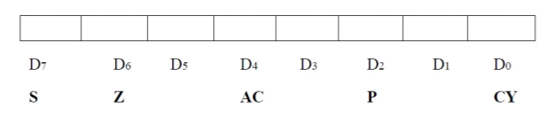
Continued….
Accumulator: The accumulator is an 8-bit register that is a part of ALU. This register is used to store 8-bit data and to perform arithmetic and logical operations. The result of an operation is stored in the accumulator. The accumulator is also identified as register A.
Flag register: The ALU includes five flip-flops, which are set or reset after an operation according to data condition of the result in the accumulator and other registers. They are called Zero (Z), Carry (CY), Sign (S), Parity (P) and Auxiliary Carry (AC) flags. Their bit positions in the flag register are shown in Figure below. The microprocessor uses these flags to test data conditions.

Slide 10
Continued….
Program Counter (PC): This 16-bit register deals with sequencing the execution of instructions. The microprocessor uses this register to sequence the execution of the instructions. The function of the program counter is to point to the memory address from which the next byte is to be fetched. When a byte is being fetched, the program counter is automatically incremented by one to point to the next memory location.
Stack Pointer (SP): The stack pointer is also a 16-bit register, used as a memory pointer. It points to a memory location in R/W memory, called stack. The beginning of the stack is defined by loading 16- bit address in the stack pointer.
Instruction Register/Decoder: It is an 8-bit register that temporarily stores the current instruction of a program. Latest instruction sent here from memory prior to execution. Decoder then takes instruction and decodes or interprets the instruction. Decoded instruction then passed to next stage.

Slide 11
Von Neumann Architecture
Von-Neumann proposed his computer architecture design in 1945 which was later known as Von-Neumann Architecture. It consisted of a Control Unit, Arithmetic, and Logical Memory Unit (ALU), Registers and Inputs/Outputs.
Von Neumann architecture is based on the stored-program computer concept, where instruction data and program data are stored in the same memory. This design is still used in most computers produced today.
A Von Neumann-based computer:
-uses a single processor
-uses one memory for both instructions and data.
-executes programs following the fetch-decode-execute cycle

Slide 12
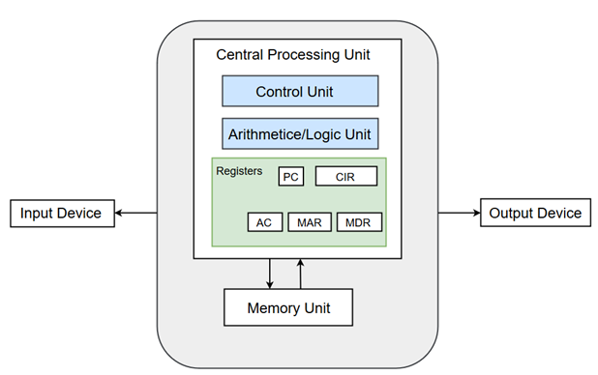

Slide 13
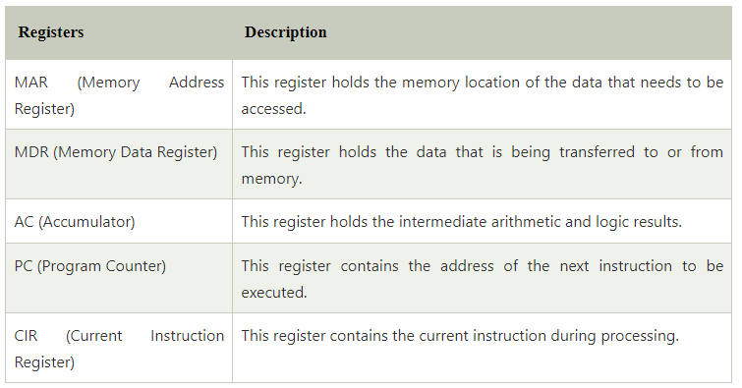
Registers
Registers refer to high-speed storage areas in the CPU. The data processed by the CPU are fetched from the registers.
Following is the list of registers that plays a crucial role in data processing.

Slide 14
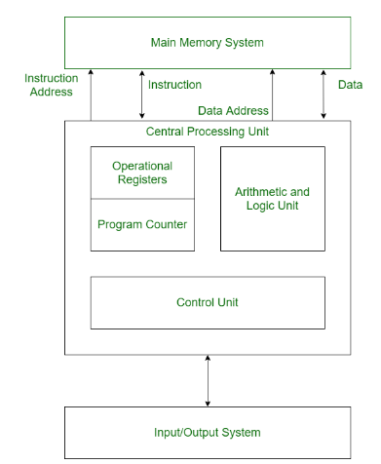
Harvard Architecture
Harvard architecture is a type of computer architecture that separates its memory into two parts so data and instructions are stored separately. The architecture also has separate buses for data transfers and instruction fetches. This allows the CPU to fetch data and instructions at the same time.

Slide 15
Buses
Buses are used as signal pathways. In Harvard architecture, there are separate buses for both instruction and data. Types of Buses:
Data Bus: It carries data among the main memory system, processor, and I/O devices.
Data Address Bus: It carries the address of data from the processor to the main memory system.
Instruction Bus: It carries instructions among the main memory system, processor, and I/O devices.
Instruction Address Bus: It carries the address of instructions from the processor to the main memory system.
Operational Registers
There are different types of registers involved in it which are used for storing addresses of different types of instructions. For example, the Memory Address Register and Memory Data Register are operational registers.
Program Counter
It has the location of the next instruction to be executed. The program counter then passes this next address to the memory address register.

Slide 16
Arithmetic and Logic Unit
The arithmetic logic unit is that part of the CPU that operates all the calculations needed. It performs addition, subtraction, comparison, logical Operations, bit Shifting Operations, and various arithmetic operations.
Control Unit
The Control Unit is the part of the CPU that operates all processor control signals. It controls the input and output devices and also controls the movement of instructions and data within the system.
Input / Output System
Input devices are used to read data into main memory with the help of CPU input instruction. The information from a computer as output is given through Output devices. The computer gives the results of computation with the help of output devices.

Slide 17
Assignment
Write down the differences between Von Neumann and Harvard Architecture.

Slide 18
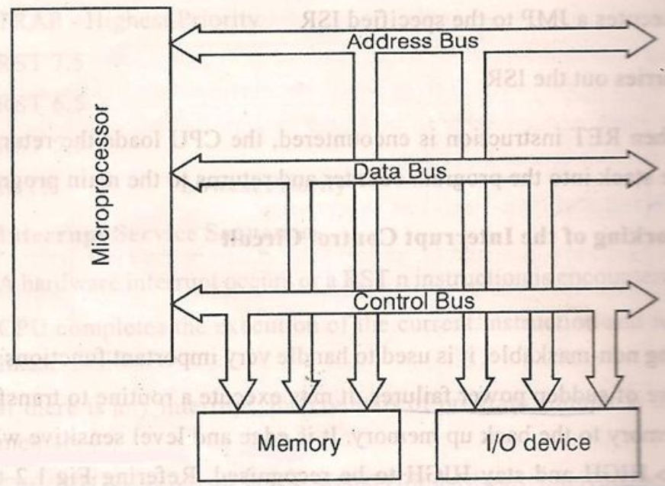
Architecture of Microprocessor

Slide 19
Continued….
Address Bus: It carries the address, which is a unique binary pattern used to identify a memory location or an I/O port. For example, an eight bit address bus has eight lines and thus it can address 2⁸ = 256 different locations. The locations in hexadecimal format can be written as 00H – FFH.
Data Bus: The data bus is used to transfer data between memory and processor or between I/O device and processor. For example, an 8-bit processor will generally have an 8-bit data bus and a 16-bit processor will have 16-bit data bus.
Control Bus: The control bus carry control signals, which consists of signals for selection of memory or I/O device from the given address, direction of data transfer and synchronization of data transfer in case of slow devices.

